Slide 1
Mindful Mondays
Session 3: May 5, 2025
Topic: Mindful Time Management

Slide 2
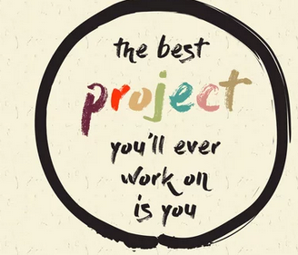
Overview: How Mindfulness Can Help You Manage Time More Effectively
How we use our 24 hours can drastically impact our productivity and well-being. This session is all about using mindfulness to
Manage time more effectively
Prioritize what matters most
Create a schedule that supports well-being.
Mindfulness
Not just slowing down but focusing
Manage time without feeling overwhelmed.
Make more conscious choices, reduce distractions, and approach tasks with clarity and intention.
Notes:
We all have the same 24 hours in a day, but how we use those hours can drastically impact our productivity and well-being. This session is all about using mindfulness to manage your time more effectively by focusing on one task at a time, prioritizing what matters most, and creating a schedule that supports your well-being.
Mindfulness isn’t just about slowing down—it’s about focusing on the present moment, which is key to managing time without feeling overwhelmed. By being present in the moment, we can make more conscious choices, reduce distractions, and approach tasks with clarity and intention.

Slide 3
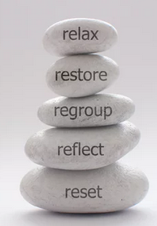
Key Takeaways for Today:
How mindfulness helps with focus, reducing procrastination, and staying in the moment
The importance of task prioritization and breaking down complex projects
Creating a mindful schedule that balances work and self-care
Notes:
Three Major Takeaways from Today’s Session
Mindfulness for Focus Learn how mindfulness techniques can improve concentration, reduce procrastination, and help you stay present and engaged in the moment.
Effective Task Management Discover the value of prioritizing tasks and breaking complex projects into manageable steps to increase productivity and reduce overwhelm.
Balanced Scheduling Understand how to create a mindful schedule that promotes both efficiency and self-care—helping you stay productive without burning out.
This session is designed to equip you with practical tools to boost your productivity while maintaining your well-being.

Slide 4
Mindfulness & Executive Functioning
How Mindfulness Strengthens Your Mental Time Management Tools
Executive functioning refers to the brain’s ability to plan, focus, remember instructions, and manage multiple tasks successfully. When executive function is taxed—by stress, distraction, or overload—time management suffers.
Mindfulness helps by:
Improving Focus & Attention Control
Strengthening Working Memory
Supporting Emotional Regulation
Boosting Task Initiation & Follow-Through
Mindful time management: a neuroscience-backed way to support the very systems that help you thrive at work and in life.
Notes:
Executive functioning refers to the brain’s ability to plan, focus, remember instructions, and manage multiple tasks successfully. When executive function is taxed—by stress, distraction, or overload—time management suffers.
Mindfulness helps by:
Improving Focus & Attention Control Practicing presence trains your brain to stay with one task longer, reducing distractions and impulsive switching.
Strengthening Working Memory Mindfulness builds mental clarity, which supports remembering tasks, deadlines, and steps in a project.
Supporting Emotional Regulation When you're overwhelmed, it's easy to freeze, avoid, or rush. Mindfulness creates space to respond intentionally, not react.
Boosting Task Initiation & Follow-Through Mindful awareness helps you notice when you're stuck—and gently shift back into motion without harsh self-judgment.
Mindful time management isn’t just a nice idea—it’s a neuroscience-backed way to support the very systems that help you thrive at work and in life.

Slide 5
Mindfulness & Task Prioritization
Mindfulness is a powerful tool that helps us pause and ask: What truly matters right now?
Prioritization in Practice
Work Project vs. Emails - Imagine you have a big project due tomorrow, and 20 emails are waiting for your attention. Which task should you handle first and why?
Personal Responsibilities vs. Work Deadlines - Maybe you have a doctor’s appointment and a work deadline. Which task should you handle first and why?
Mindfulness helps you stay grounded and focused on what needs your attention right now, instead of feeling stressed by everything at once.
Optional Practice: Eisenhower Matrix
Use your to-do or task dump list to plot tasks on the Eisenhower Matrix.
Why? The matrix provides a quick visual of the urgency and importance of tasks so you can quickly prioritize them.
Notes:
In a world full of competing demands and constant notifications, it’s easy to react instead of respond. But by taking a mindful moment to step back, we can evaluate which tasks align with our most important goals and values—not just what feels urgent. Instead of powering through a long to-do list on autopilot, mindfulness invites us to intentionally choose how we spend our energy and attention. This shift not only improves focus—it reduces stress and brings more meaning to our day.
Let’s take a look a few prioritization examples. For the first example, let’s imagine you have a big project due tomorrow, and 20 emails are waiting for your attention. Let’s take a moment to discuss which task should be handled first and why. With mindfulness, you pause to consider: Which task will have the biggest impact right now? In this case, focusing on the project helps you meet your deadline, while emails can wait until a scheduled break. Being mindful about this choice helps prevent overwhelm and sets you up for success.
Personal Responsibilities vs. Work Deadlines - Maybe you have a doctor’s appointment and a work deadline. Which task should you handle first and why? Mindfulness helps you assess both. If your health needs attention, that becomes the priority. Afterward, you can block time to finish the report. By staying grounded in the present, you make choices that respect both your responsibilities and your well-being.
Mindfulness helps you stay grounded and focused on what needs your attention right now, instead of feeling stressed by everything at once.
Let’s review a tool that can further assist with establishing priorities: The Eisenhower Matrix
Use your to-do or task dump list to plot tasks on the Eisenhower Matrix.
The Eisenhower Matrix provides a quick visual of the urgency and importance of tasks so you can quickly prioritize them and get on with the fun part: action.

Slide 6
What is Eisenhower Matrix?
 | Urgent | Not Urgent
Important | Definition: Tasks that are both time-sensitive and aligned with core goals (personal, departmental, or organizational). Examples: A project deadline tied to strategic outcomes Crisis response Health appointments Why It Matters: These need your immediate, focused attention and have direct consequences if delayed. | Definition: High-value tasks that support long-term goals, development, or relationships but don’t come with immediate pressure. Examples: Strategic planning Relationship-building with key partners Personal wellness routines Why It Matters: This is the “growth zone.” Mindfully making space for these tasks prevents burnout and reactive living.
Not Important | Definition: Tasks that feel pressing but aren’t aligned with your highest priorities. Often interruptions or tasks that can be delegated. Examples: Most emails and some meetings Others’ last-minute requests that aren't tied to your highest priorities Why It Matters: These can drain your energy and focus. Evaluate what can be scheduled for later, delegated, or declined. | Definition: Low-impact, non-essential activities that neither support your goals nor require immediate action. Examples: Doomscrolling Excessive task-switching Unproductive multitasking Why It Matters: These are great to eliminate or reserve as intentional breaks. Mindfulness helps you catch when you're drifting here unconsciously.
Notes:
If you’re wondering, what exactly is the Eisenhower Matrix? It's a tool designed to help prioritize tasks by organizing them into four quadrants, allowing you to focus on what truly matters and complete tasks strategically.
Quadrant 1 (Urgent and Important): Tasks in this category are both time-sensitive and crucial for achieving your core goals, whether personal, departmental, or organizational. These should be handled immediately and with high priority.
Quadrant 2 (Important, Not Urgent): These tasks are significant for long-term success, personal growth, and relationship-building, but they don’t require immediate attention. Prioritizing these tasks can help you stay aligned with long-term goals, though they can easily be overlooked in the rush of daily demands.
Quadrant 3 (Urgent, Not Important): Tasks that fall into this quadrant feel urgent but aren’t aligned with your highest priorities. Often, these are interruptions or tasks that can be delegated to others, freeing you up to focus on more impactful activities.
Quadrant 4 (Not Urgent, Not Important): These are low-impact tasks that neither contribute to your major goals nor require immediate action. These tasks often waste time and should be minimized or eliminated altogether.

Slide 7
Single-Tasking, Not Multi-Tasking
Many of us are used to juggling several tasks at once, but mindfulness teaches us to focus on one thing at a time.
Emails During a Meeting Have you ever tried responding to emails during a meeting? Anyone want to share what typically happens? Focusing fully on the task at hand can increase both your productivity and your sense of accomplishment.
Report vs. Phone Call Let’s say you’re trying to complete a report while also talking on the phone. This is another classic example of multi-tasking. Practicing mindfulness by focusing on one task at a time will make you feel more centered and help you be more efficient.
Optional Practice: The Rule of 3
Start your day with intention by choosing just three key tasks to focus on.
This helps reduce overwhelm and brings clarity to what truly matters.
If you complete all three, consider it a success—anything extra is a bonus!
Supports mindful decision-making and boosts your sense of accomplishment.
Notes:
Let’s talk about the difference between single-tasking and multi-tasking. Many of us are accustomed to juggling several tasks at once, but mindfulness encourages us to slow down and focus on one thing at a time. This doesn’t mean doing less—it means being more present and intentional.
Emails During a Meeting
Have you ever tried responding to emails during a meeting? Anyone want to share what typically happens? Chances are, you’re not fully engaged in either activity. You might miss important points from the meeting and send emails that require follow-up later. By practicing mindfulness, you can fully participate in the discussion and, afterward, set aside uninterrupted time to respond to emails more effectively.
Focusing on one task at a time not only boosts productivity but also increases your sense of accomplishment.
Report vs. Phone Call
Here’s another common example: trying to write a report while talking on the phone. Instead of dividing your attention, try this: focus entirely on the phone call. Be fully present. Once it ends, shift your attention to the report. You’ll likely find the work flows more easily, and the quality improves because your energy isn’t split.
Mindful single-tasking helps you feel more centered, less scattered, and ultimately more efficient.
Optional Practice: The Rule of 3
Start your day with intention by selecting three key tasks to focus on.
This practice reduces overwhelm and clarifies what truly matters.
If you complete all three, consider your day a success—anything extra is a bonus!
It’s a simple but powerful way to support mindful decision-making and boost your sense of achievement.

Slide 8
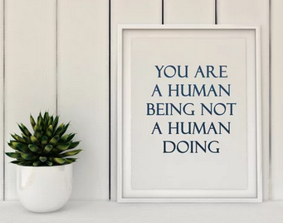
Mindful Scheduling
Another key element of mindful time management is creating a mindful schedule. Block out time intentionally for both your work and your well-being.
Work Block vs. Rest Block Considering scheduling a 90-minute block of time for deep work when you have an important project due. But don’t forget to also schedule a 10–15-minute break afterward. If you don’t plan for breaks, you’ll risk burning out or becoming distracted. Mindfulness helps you recognize when you need to step away and recharge, which will improve your overall productivity.
Personal vs. Work Tasks Imagine your day consists of both work meetings and personal tasks. If you don’t plan your time effectively, you might feel rushed from one task to the next. But if you block time for both, like scheduling a work meeting in the morning and a personal task in the afternoon, you’ll have a better sense of balance and won’t feel as frazzled.
Mindful scheduling helps you honor both your responsibilities and your need for personal time.
Notes:
Another key element of mindful time management is creating a mindful schedule. This involves intentionally blocking out time for both your work and your well-being. Mindfulness isn’t just about being present with tasks, but also with your need for rest and self-care.
Work Blocks vs. Rest Blocks
When you’re tackling an important project, consider scheduling a 90-minute block of focused time for deep work. But just as important as the work is the break that follows—build in a 10–15-minute rest block to recharge.
If you skip breaks, you increase your risk of burnout and distraction. Mindfulness helps you tune into your energy levels and recognize when it’s time to pause. Taking intentional breaks will actually enhance your focus, creativity, and overall productivity.
Personal Tasks vs. Work Tasks
Many of us juggle both professional responsibilities and personal to-dos throughout the day. Without a plan, it’s easy to feel rushed and scattered.
Instead, try time-blocking for both—schedule your work meetings and also reserve space for personal tasks. For example, you might handle a work meeting in the morning and take care of a personal errand or call in the afternoon. This approach creates a greater sense of balance, helping you move through your day with more ease and clarity.

Slide 9
Exercise: Mindful Task Prioritization and Scheduling
Now, let’s practice mindful task prioritization and scheduling. Find a comfortable seat and close your eyes.
Take a deep breath and bring your attention to the present moment.
Reflect on your tasks for today or the week. Which ones are most important? Which will have the greatest impact if completed first?
Imagine creating a mindful schedule that honors both your productivity and your well-being.
As you make these adjustments, notice any changes in how you feel.
Notes:
Now that we’ve explored mindful time management strategies, let’s take a moment to practice applying them with intention.
Find a comfortable seat. Gently close your eyes or soften your gaze—whatever feels right for you in this moment.
Take a deep breath in… and slowly exhale. Bring your attention fully into the present moment. Let go of anything that came before this and anything that’s waiting for you afterward.
Begin to reflect on your upcoming tasks—either for today or for the week ahead.
Which tasks are truly most important?
Which ones will have the greatest impact if completed first?
Perhaps you have a critical deadline—that might take priority. Or maybe you’ve been neglecting your own well-being—and today, self-care needs to come first.
Now, imagine building a schedule that honors both your productivity and your well-being.
Where can you intentionally add breaks?
How might you set healthy, realistic boundaries around your time?
What can you say no to, to make room for what matters most?
As you mentally rearrange your schedule, check in with yourself:
How do you feel now?
More grounded? Less rushed? Or perhaps something else?
There’s no right or wrong answer—just notice.
Take one more deep breath in… and release. When you’re ready, gently open your eyes or bring your focus back to the space around you.
Carry this sense of clarity and intention with you as you move through the rest of your day.

Slide 10
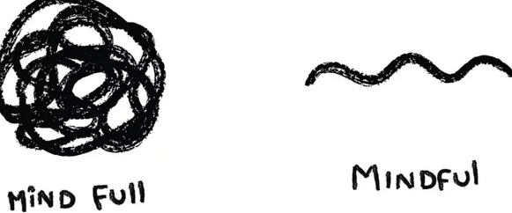
Reflection & Wrap-Up
Check in with yourself throughout the day and week.
Are you focusing on the present moment?
Are tasks intentional and aligned?
At the end of your day, reflect mindfully on one task.
Was it easier to focus on it when you weren't distracted? How did it feel to give it your full attention?
Thank you for taking the time to join today’s session. We look forward to seeing you next month for our next session: The Power of Now: Living in the Present Moment. Make sure to wear comfortable shoes and bring an umbrella, as we plan to take next month’s session outdoors (Red Square)!
Notes:
As we wrap up today’s session, I encourage you to check in with yourself regularly throughout the day and week.
Are you staying connected to the present moment?
Are you prioritizing tasks that feel intentional and aligned with your values and goals?
At the end of each day, take a brief moment to reflect: What’s one task you completed mindfully today?
Was it easier to focus without distractions? How did it feel to give that task your full attention?
By practicing mindful time management, we can reduce overwhelm, feel more grounded, and create meaningful space for both productivity and well-being.
Thank you so much for being here today. We look forward to seeing you at next month’s session: The Power of Now – Living in the Present Moment.
🌿 A quick note: we plan to take the session outdoors, so please wear comfortable shoes and bring an umbrella—just in case!

Slide 11
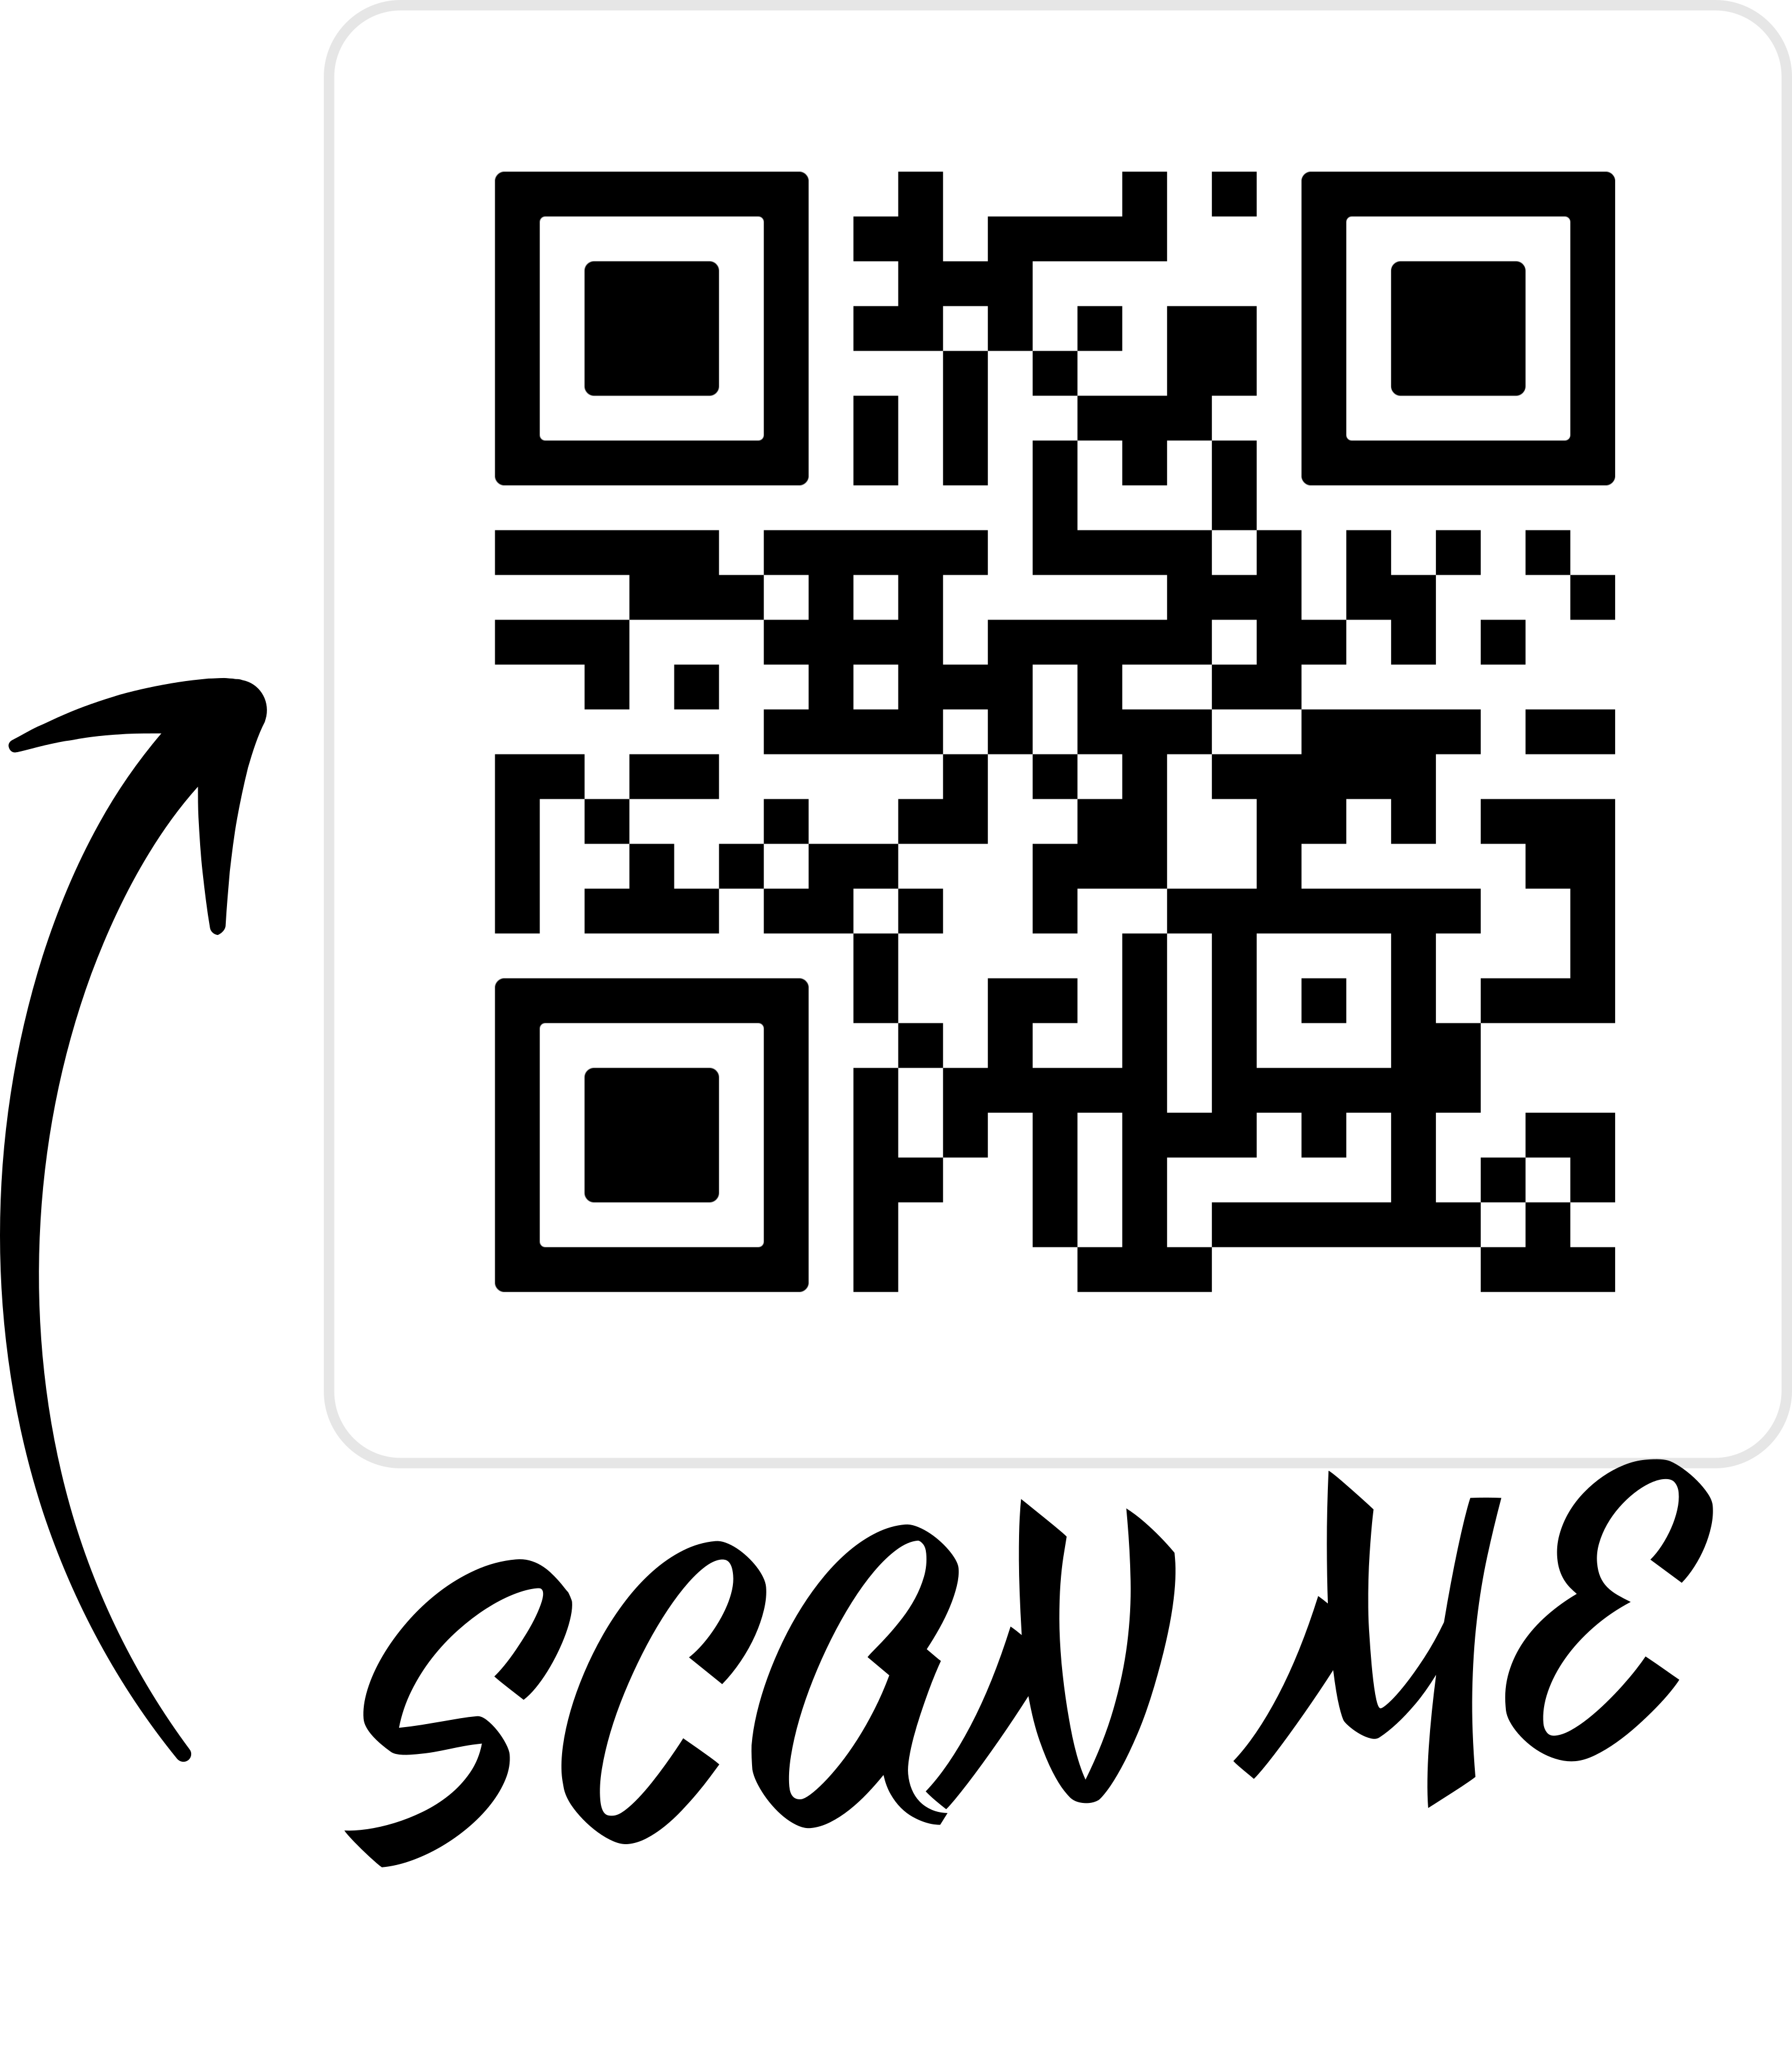
Thank you for taking this time for yourself today!
Please take a moment to complete the online survey to share your feedback or any interests for future topics.
The survey is found within the “Launch and Schedule”section at this URL: https://hr.kzoo.edu/benefits/healthcare/wellness/mindful-mondays/
Notes:
If there’s enough interest, we may expand these sessions in the future. Please take a moment to complete the online survey to share your feedback or any interests for future topics.

