Slide 1

Katalyst: Staff Development Program
Pathway 1: Orientation to Higher Ed at K
(K)navigating K: Working Better Together
Notes:
Speaker Notes: Welcome everyone and thank you for taking the time to be here. Today’s session is called (K)navigating K: Working Better Together because our goal is to make the invisible systems of the College more visible. This is not a training on policies or procedures—it’s about understanding how our offices connect, where work flows, and how we can collaborate more effectively across campus.

Slide 2
Why This Workshop?
Staff survey results show strong interest in institutional knowledge and campus systems
Time and workload identified as key barriers
This session delivers high-impact clarity in 60 minutes
Notes:
Speaker Notes: This workshop was designed directly in response to staff survey feedback. Many of you told us you want more institutional knowledge—how offices interact, how decisions are made, and where to go first. At the same time, you shared that time and workload are real barriers. This session is intentionally designed to be high-impact and respectful of your time.

Slide 3
Purpose & Outcomes
This interactive session helps staff:
Understand how key offices function individually and collaboratively
See how decisions, approvals, and information flow across campus
Navigate campus systems with greater confidence
Notes:
Speaker Notes: Our purpose today is threefold: first, to clarify what key offices do; second, to show how information and approvals move across campus; and third, to help you feel more confident navigating campus systems. If you leave with a clearer mental map of how work flows at K, this session has done its job.

Slide 4
Learning Objectives
By the end of the session, participants will be able to:
Understand how work moves across campus
Recognize centralized vs. delegated responsibilities
Practice their knowledge about office flow
Notes:
Speaker Notes: By the end of the session, you should be able to identify which offices are involved in common situations, understand where responsibilities are centralized versus shared, and apply systems thinking to everyday work. This is about reducing friction and frustration—not adding steps.

Slide 5
First things first...introductions
Name
Department and how long you have been at K
What do you love to do as the weather gets warmer?

Slide 6
K as a Connected System
Offices do not work in isolation
Most work crosses multiple areas
Clear pathways reduce delays and frustration
Quick Poll: Which office do you interact with most?
Quick Poll: What burning question about K do you have? (write on post-it note)
Notes:
Speaker Notes: No office at K works in isolation. Most initiatives, requests, and decisions move across multiple areas. When we understand those connections, work moves faster and collaboration feels less frustrating. I’ll start with a quick poll to get a sense of which offices you interact with most.

Slide 7
How is work organized at K?
Office of the President
Office of the Provost
Advancement / Development / Alumni Engagement
Business Office (Payroll and Finance)
Facilities
Human Resources (Student Employment)
Information Services
Student Development
Faculty/curriculum
Communications
Notes:
Speaker Notes: Today we’re highlighting offices that staff most often interact with when work crosses departmental lines. This is not an exhaustive list, but it represents the core administrative and student-facing systems that keep the College running. A quick clarification before we go further: Student Employment lives in Human Resources, and Payroll and Finance live in the Business Office, for the purposes of this training. This reflects how work is structured at K and helps avoid confusion about where to start.

Slide 8
What the amount of time (percentage) that students are in a classroom at K on average?
Notes:
Speaker Notes: only 40% - which means we all have an impact on the 60%!

Slide 9
But wait! Who teaches all those classes?
Faculty
Faculty are divided into academic departments (Econ, Biol, Math, etc) and the academic department proposes to the entire faculty any proposed changes to the major or curriculum. Faculty are "in charge" of how K students experience the classroom.
Notes:
Speaker Notes:

Slide 10
Why are we here?
At K, our mission is to prepare our graduates to better understand, live successfully within, and provide enlightened leadership to a richly diverse and increasingly complex world.
Notes:
Speaker Notes: This is the official mission statement for K college. Does your office/dept have a mission statement?

Slide 11
Centralized v Decentralized Decision Making
Centralized Decision-Making
Decentralized (Delegated) Decision-Making
Authority concentrated at the top
Standardized policies and oversight
Slower, but consistent
Best for high-risk or institution-wide decisions
Authority distributed to departments/units
Faster and more flexible
Empowers local expertise
Best for operational or day to day decisions

Slide 12
Office Snapshot Format
Each snapshot highlights:
What the office does
When they are involved
One common misconception
Focus: give an overview (systems awareness), not policy detail
Notes:
Speaker Notes: Please take some time to review the provided office snapshots. Each office snapshot is intentionally brief. We’ll focus on what the office does, when they’re typically involved, and one common misconception. This keeps the focus on understanding the system rather than diving into policy details. We will engage with the information presented in the snap shots during a brief interactive activity.

Slide 13
Interactive Activity – Follow the Workflow
Small groups map:
Which offices are involved
Where approvals occur
Common bottlenecks
Uses realistic campus case studies, K - Studies
Notes:
Speaker Notes: Now we’ll shift from listening to doing. In small groups, you’ll work through a realistic campus scenario and map which offices are involved, where approvals happen, and where delays often occur. This is about surfacing assumptions and comparing them to real workflows.

Slide 14
Group Debrief
What surprised you?
Where assumptions differed from reality?
What information, if any, helps work move faster?
Notes:
Speaker Notes: Let’s talk about what you noticed. Where were you surprised? Where did your assumptions differ from reality? These moments are where learning really happens.

Slide 15
Key Takeaways
Start with the right office
Expect cross-office collaboration
Early communication prevents delays
Each office has its own processes and workflows, early communication and understanding helps everyone get the job done!
Notes:
Speaker Notes: Three key takeaways: start with the right office, expect collaboration across offices, and communicate early. Most delays happen not because people are unhelpful, but because information arrives late or incomplete.

Slide 16
Resources & Wrap-Up
Who to Contact & When guide
Workflow visuals
Feedback QR code
Notes:
Speaker Notes: You’ll receive a Who-to-Contact guide and workflow visuals after the session. Please also share feedback so we can refine future workshops.

Slide 17
How Work Flows at K
Academic Path
Academic Path: President → Provost → Registrar / Departments
Employment Path: Provost or Supervisor → Human Resources → Business Office → Information Services
Financial Path: Department → Business Office → President/Provost (as needed)
Student Support Path: Faculty/Staff → Student Development / CARE → Counseling / Registrar (as needed)
Communication Path: Department → Marketing & Communication → Campus/External Audiences
Alumni and Advancement Path: Department → Advancement or Alumni Relations
Alumni and Advancement Path
Employment Path
Campus Need or Idea
Communication Path
Financial Path
Student Support Path
Notes:
Speaker Notes: This visual shows that most work at Kalamazoo College begins with a need or idea, not with a specific office. From there, the work flows through one or more interconnected pathways depending on the situation.
Some work follows a single path, but most initiatives touch multiple paths at once. Understanding these common routes helps you start in the right place, anticipate who else may be involved, and move work forward more efficiently. The goal isn’t to memorize this diagram — it’s to build a mental map that reduces guesswork, delays, and unnecessary handoffs.

Slide 18
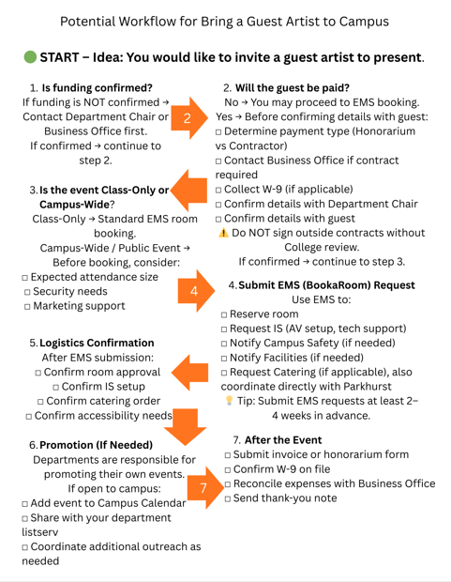
How Work Flows at K
Notes:
Speaker Notes: This visual shows that most work at Kalamazoo College begins with a need or idea, not with a specific office. From there, the work flows through one or more interconnected pathways depending on the situation.
Some work follows a single path, but most initiatives touch multiple paths at once. Understanding these common routes helps you start in the right place, anticipate who else may be involved, and move work forward more efficiently. The goal isn’t to memorize this diagram — it’s to build a mental map that reduces guesswork, delays, and unnecessary handoffs.

Slide 19
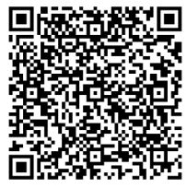
THANK YOU!
Feedback QR code
URL: https://hr.kzoo.edu/current-employees/employee-relations/training-and-development/katalyst-staff-development-program/post-training-survey/
Notes:
Speaker Notes: Thank you for your time and for the work you do to keep K running every day.

